Slide 1

Predicting Myocardial Infarction: A Comparative Analysis of ALGORITHMS on PATIENT Data and Image-Based Classification of ECG Patterns
Group 10 Members :
Archana
Sana
Diab
Harshitha
Furwa

Slide 2

MYOCARDIAL INFARCTION: A Global LIFE THREAT
HYPOTHESIS
Myocardial Infarction (MI) is one of the leading causes of death worldwide.
According to Rohani et al. (2022), 18.8% of the patients hospitalized with MI diagnosis pass away, making it a major public health concern.
Early diagnosis can significantly reduce the risk of MI and prevent possible death in patients.
Machine learning can analyze vast amounts of patient data, uncover hidden patterns, and predict the likelihood of MI more accurately than traditional methods.

Slide 3
Dataset 1: Heart Disease (Statlog Cleveland and Hungary)
1190
Classes: 2 (Presence or absence of heart disease)
Features: 12 attributes, including age, sex, chest pain type, resting blood pressure, cholesterol, fasting blood sugar, rest ECG, max heart rate, exercise-induced angina, and ST depression.
Examples: 1190 data points, 12 columns
Advantages: structured, tabular data, derived from clinical tests
Source: Heart Disease Dataset on Kaggle
Previous Use: This dataset has been widely used in various machine learning models to predict heart disease, including logistic regression, decision trees, and neural networks. It has been cited in studies focusing on CVD risk assessment using machine learning algorithms.

Slide 4
Dataset 1: Heart Disease (Statlog Cleveland and Hungary)
age | sex | chest pain type | resting bp s | cholesterol | fasting blood sugar | resting ecg | max heart rate | exercise angina | oldpeak | ST slope
40 | 1 | 2 | 140 | 289 | 0 | 0 | 172 | 0 | 0 | 1
49 | 0 | 3 | 160 | 180 | 0 | 0 | 156 | 0 | 1 | 2
37 | 1 | 2 | 130 | 283 | 0 | 1 | 98 | 0 | 0 | 1
48 | 0 | 4 | 138 | 214 | 0 | 0 | 108 | 1 | 1.5 | 2

Slide 5
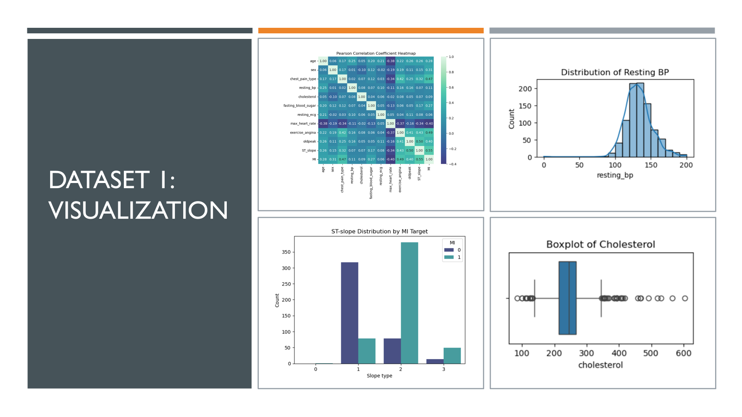
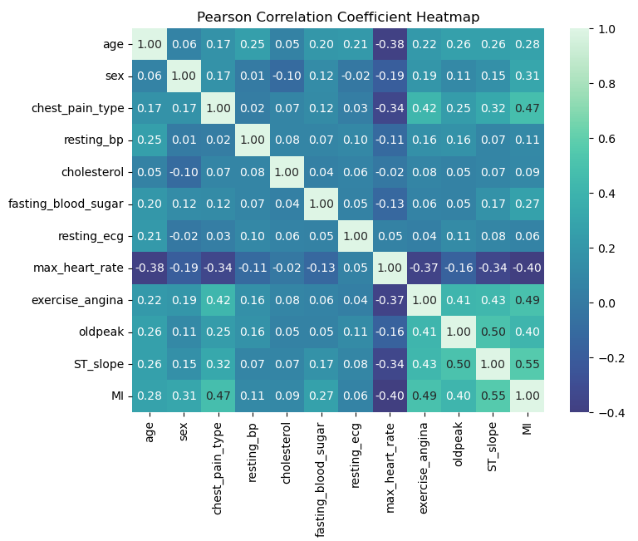
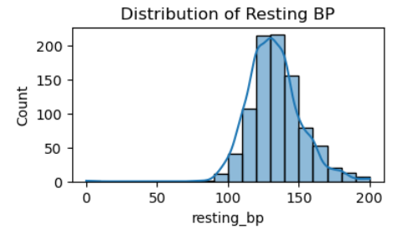
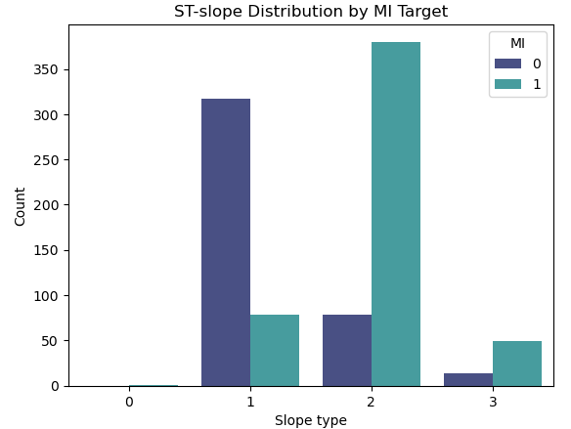
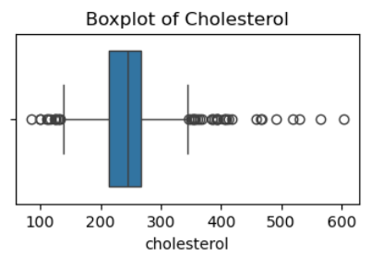
Dataset 1: Visualization

Slide 6
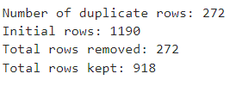
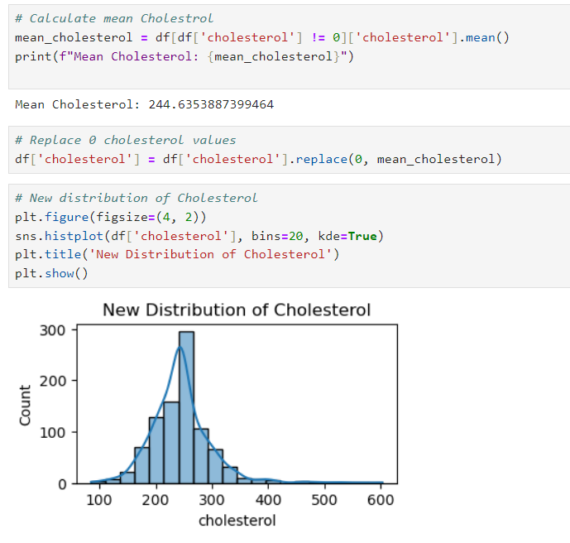

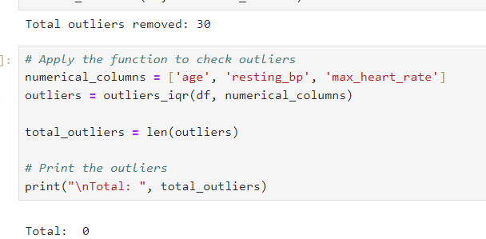
Dataset 1: Pre-processing
Duplicate rows removal
Cholesterol 0 values replaced:
Split train, test, and validation:
Removing outliers:

Slide 7
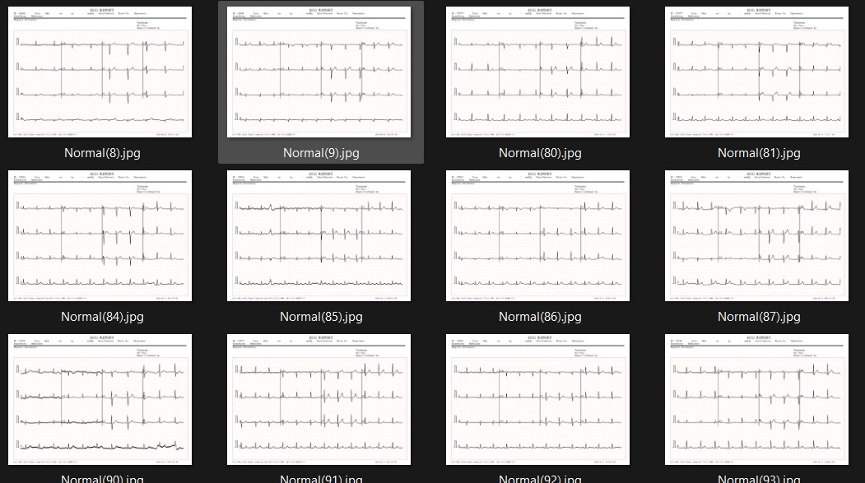
Dataset 2: ECG Image Dataset
Classes: 2 (Normal vs. Abnormal ECG readings)
Features: Image data representing ECG waveforms.
Examples: Thousands of ECG images with labels indicating normal or abnormal heart activity.
Advantages: ECG readings are a primary diagnostic tool for detecting heart conditions, automatically detect abnormalities, quicker diagnoses
Source: ECG Image Dataset on Kaggle
Previous Use: This dataset has been used in image classification models, specifically convolutional neural networks (CNNs), to detect heart conditions from ECG images. Research in this area has demonstrated high accuracy rates for models trained on these types of datasets.

Slide 8
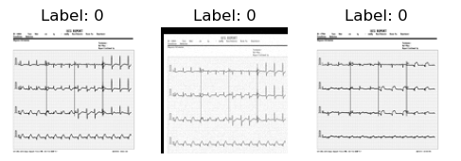
DaTASET 2: PREPROCESSING
The image preprocessing involves:
Grayscaling
Resizing
Normalizing
Flattening
Rotations
Shifting
Gaussian Noise
Brightness & contrast

Slide 9
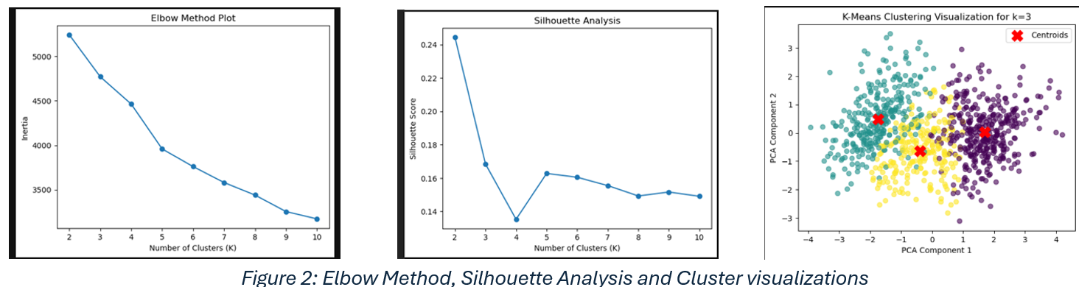
Clustering K-MEANS
Optimal Clusters Determination: The Elbow method and silhouette analysis were used to determine the best value for k ; k=4 marked a knee point for diminishing returns, but k=3 was selected for its balance and cluster purity (79.2%).
Cluster Labeling: The dataset was augmented with a new column indicating the cluster (0, 1, or 2) for each record, enabling detailed group analysis.
Cluster 0 - Older Men Group with Lower Heart rate: Avg. age 57.7) with low max heart rates (121), predominantly male (88.8%), and a high incidence of exercise-induced angina (85.43%).
Cluster 1 - Younger Men/Women Group with Higher Heart Rate: Avg. age 49.55) with balanced gender distribution (56.57% male), high max heart rates (154), and low MI likelihood (13%).
Cluster 2 - Middle-Aged Group with Moderate Heart Rate: Middle-aged individuals (avg. age 51.94) with moderate max heart rates (138) and an intermediate MI likelihood (55%), requiring moderate attention

Slide 10
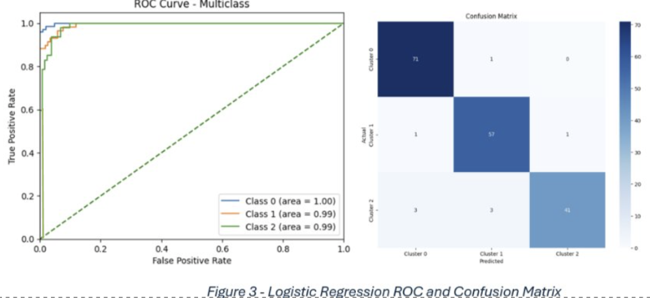
ML ALGORITHMS 1.LOGISTIC REGRESSION
A supervised classification algorithm calculating probabilities using the logistic sigmoid function.
Applied to predict myocardial infarction (MI) using clinical features like age, blood pressure, and heart rate.
Dataset split into training and testing sets; features standardized for better performance.
Model evaluation includes confusion matrix, ROC curve, and accuracy score , showing reliable MI prediction.

Slide 11
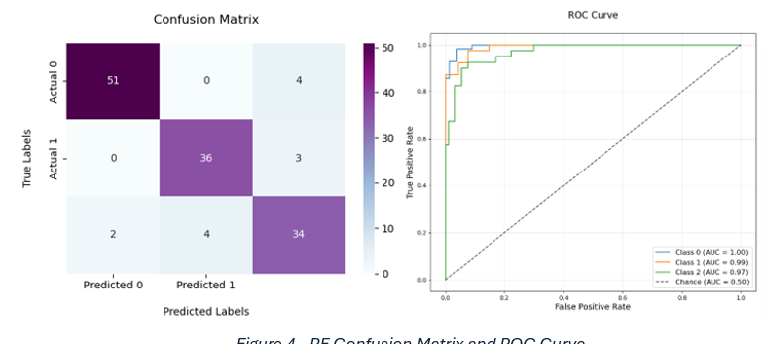
2.DECISION TREE
Random Forest Structure: Utilizes a tree-like structure for classification and regression, with decision rules at nodes and outcomes at leaves.
Limitations and Random Forest Solution: Single trees risk overfitting; Random Forest mitigates this by averaging predictions from multiple decision trees through ensemble learning.
Model Optimization: Class weight balancing and GridSearch were applied to address imbalanced clusters, improving model performance.
Performance Metrics: Achieved a validation accuracy of 92.70%, cross-validation accuracy of 91% (±0.02), and test accuracy of 90.03%, supported by balanced confusion matrices and ROC curves.
Clinical Utility: Demonstrated significant predictive power, leveraging clinical data to assess MI risk based on patient cluster assignments.

Slide 12
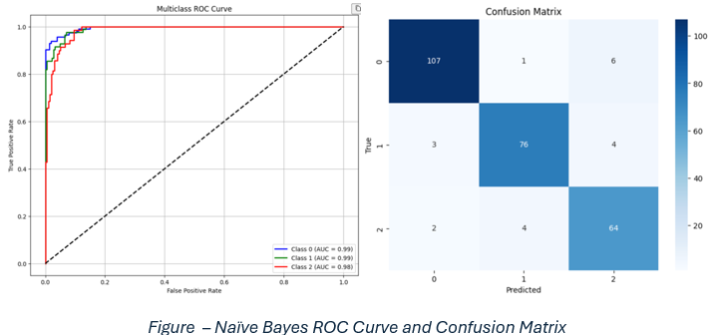
3.Naïve Bayes
It is a probabilistic ML algorithm based on Bayes theorem.
Dimensionality Reduction: Principal Component Analysis (PCA) was employed to optimize the feature set for enhanced classification performance.
Performance Metrics: Achieved 93% test accuracy, demonstrating reliability in predicting myocardial infarction (MI) and other medical conditions.
Model Evaluation: Accuracy, confusion matrix, and classification reports highlight its strength as a simple yet effective tool for real-world medical data analysis.

Slide 13
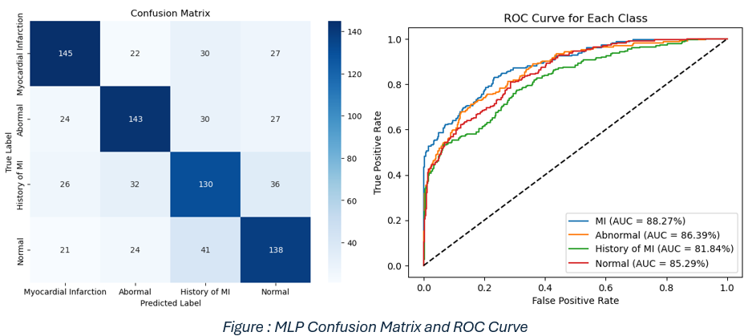
DEEP LEARNING ALGORITHMS 1.mlp
Data Preparation: Images were converted to NumPy arrays, PCA was applied for dimensionality reduction, and augmented data was used for improved training.
Model Architecture: Composed of an input layer (256 neurons), two hidden layers (256 and 128 neurons with ReLU activation), and an output layer (4 neurons with Softmax activation).
Training Process: Trained using categorical cross-entropy loss and the Adam optimizer, ensuring efficient learning for multiclass classification tasks.
Performance Metrics: Achieved a test accuracy of 62.05%, evaluated through accuracy, loss, confusion matrix, classification reports, and ROC AUC analysis, indicating room for improvement.

Slide 14
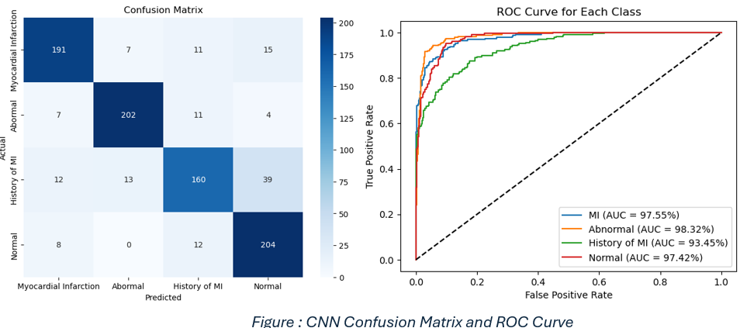
2.cnn
Suitability for Medical Data: Particularly effective for tasks like ECG image classification, capturing subtle variations critical for accurate medical diagnosis.
Model Architecture: Consists of grayscale input images resized to 128x128 pixels, three convolutional layers (32, 64, and 128 filters) with ReLU activation and max pooling, followed by dense layers with a Softmax output layer (4 neurons).
Performance Metrics: Achieved a test accuracy of 84.49%, showcasing strong class discrimination for ECG image-based myocardial infarction (MI) prediction.
Evaluation Techniques: Assessed using metrics such as accuracy, loss, confusion matrix, classification reports, and ROC AUC analysis, validating its robust performance.

Slide 15
CONCLUSIONS
Algorithm Diversity: Multiple machine learning and deep learning algorithms were applied to analyze both clinical and ECG image data for myocardial infarction (MI) prediction.
Clustering Insights: K-Means clustering segmented patients into three distinct risk groups, providing valuable insights into MI risk factors.
Top Performers: Naïve Bays achieved the highest accuracy (93%) for clinical data, while CNNs excelled in ECG image classification with 84.49% accuracy.
Challenges Addressed: Data augmentation improved model generalization, but MLPs showed relatively lower performance (62.05%), highlighting areas for optimization.
Future Directions: Emphasized the need for further validation on diverse datasets and incorporation of explainability frameworks to enhance model transparency.

Slide 16
REFERENCES
Rohani C, Jafarpoor H, Mortazavi Y, Esbakian B, Gholinia H. Mortality in patients with myocardial infarction and potential risk factors: A five-year data analysis. ARYA Atheroscler. 2022 May;18(3):1-8. doi: 10.48305/arya.v18i0.2427. PMID: 36815954; PMCID: PMC9931944.
Pham H, Egorov K, Kazakov A and Budennyy S(2023) Machine learning-based detection ofcardiovascular disease using ECG signals: performance vs. complexity. Front. Cardiovasc. Med. 10:1229743. doi: 10.3389/fcvm.2023.1229743-
A. Velusamy, J. Akilandeswari, S. Vaanathi, M. Priya, T. Munirathinam and S. Kokila, "Enhancing Myocardial Infarction Prediction with Machine Learning: Leveraging Clinical and Demographic Data for Improved Early Detection and Patient Outcomes," 2024 OPJU International Technology Conference (OTCON) on Smart Computing for Innovation and Advancement in Industry 4.0, Raigarh, India, 2024, pp. 1-6, doi: 10.1109/OTCON60325.2024.10687656.
P. Piros, R. Fleiner, and L. Kovács, "Finding improved predictive models with Generalized Boosted Models on Hungarian Myocardial Infarction Registry," 2020 IEEE 20th International Symposium on Computational Intelligence and Informatics (CINTI), Budapest, Hungary, 2020, pp. 179-184, doi: 10.1109/CINTI51262.2020.9305814.
M. A. Taha, S. A. A. A. Alsaidi and R. A. Hussein, "Machine Learning Techniques for Predicting Heart Diseases," 2022 International Symposium on iNnovative Informatics of Biskra (ISNIB), Biskra, Algeria, 2022, pp. 1-6, doi: 10.1109/ISNIB57382.2022.10076238.

Slide 17
Any Questions?

